Slide 1

Week 3 Hour 1

Slide 2
Learning Objectives
Be familiar with the test data record sheet template
Understand how this relates to Part 2 of the Portfolio
Work through practice questions

Slide 3

What We’ve Done So Far

Slide 4

Selecting a Measure
Construct Validation (Week 2)
What is the phenomenon we’re interested in
What can this tell us about behaviour?
Choosing a scale (Week 2; Week 5)
How can this construct answer a particular question?
What scale is appropriate for measuring this construct?

Slide 5

Checking the Measure
Assumption Checks:
Uni-dimensionality (Week 4)
Tau Equivalence (Week 5)
Reliability (Week 5)
Normal Distribution (Week 2)

Slide 6
Summarising the Measure
Summary Statistics (Week 2)
Mean
Standard Deviation
Standardised Scores (Week 2, Follow-up Week 6)
Z scores
T Scores
Sten/Stanine

Slide 7
Still to Do

Slide 8

Quantifying Error (this week)
True Score + Error
How do we estimate the degree of error around a score?
How do we communicate this?

Slide 9

Providing Feedback (Next week)
We have
A question
A measure
A norm group
A degree of error
How do we communicate this in an understandable and useful way?

Slide 10

Checking for Bias
Will this measure disadvantage different groups of people?

Slide 11

Alternative Approaches to Feedback
Item Response Theory
Generalisability Theory

Slide 12
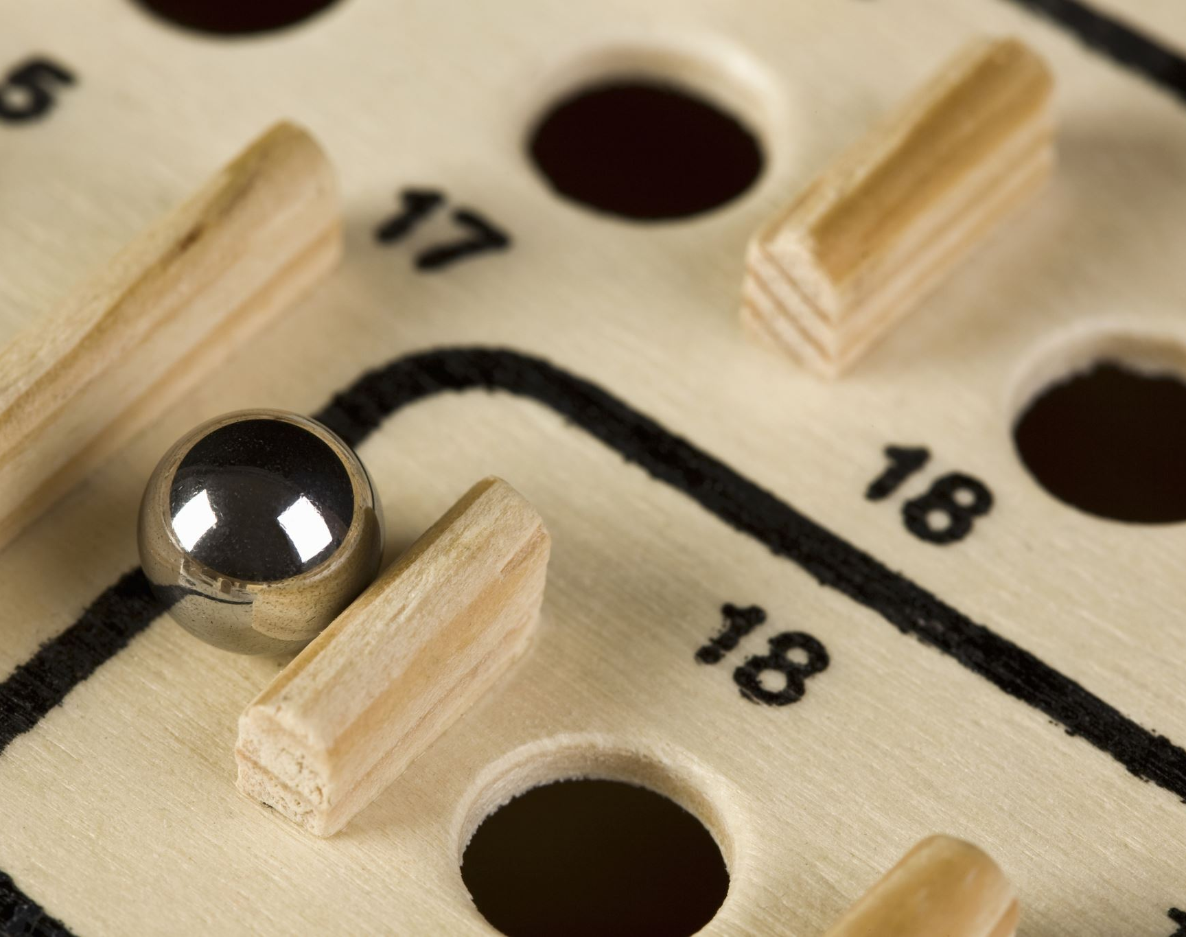
Re-cap: Standard Scores
A person scores 3 on a neuroticism scale; is this a high or a low score?

Slide 13
Re-cap: Standard Scores
A person scores 3 on a neuroticism scale; is this a high or a low score?
The mean of the scale is 3.5
LOWER SCORE

Slide 14
Re-cap: Standard Scores
How much Lower though?
It depends on the standard deviation

Slide 15
Re-cap: Standard Scores
If the standard deviation is large
Scores away from the mean are quite common
Probably not very low

Slide 16
Re-cap: Standard Scores
If the standard deviation is small
Scores away from the mean are NOT common
Probably low

Slide 17
Re-cap: Standard Scores
Lower SD
Higher SD
Raw Score = 3
Norm Group = 3.5
Norm SD = 0.2
Most people score between 3.3 and 3.7 so this score is quite rare
Raw Score = 3
Norm Group = 3.5
Norm SD = 1.0
Most people Score between 2.5-4.5 so 3 isn’t that rare a score

Slide 18
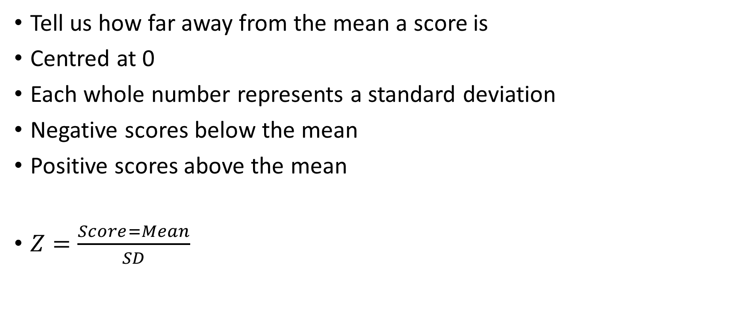
Z Scores
Tell us how far away from the mean a score is
Centred at 0
Each whole number represents a standard deviation
Negative scores below the mean
Positive scores above the mean
$Z=\frac{Score=Mean}{SD}$

Slide 19
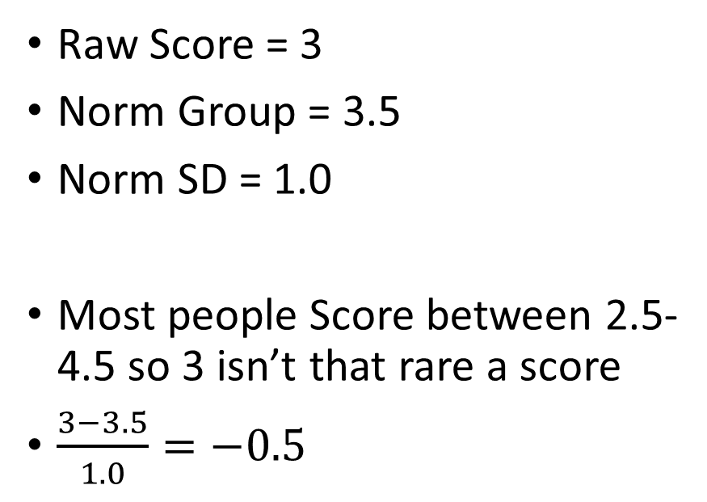
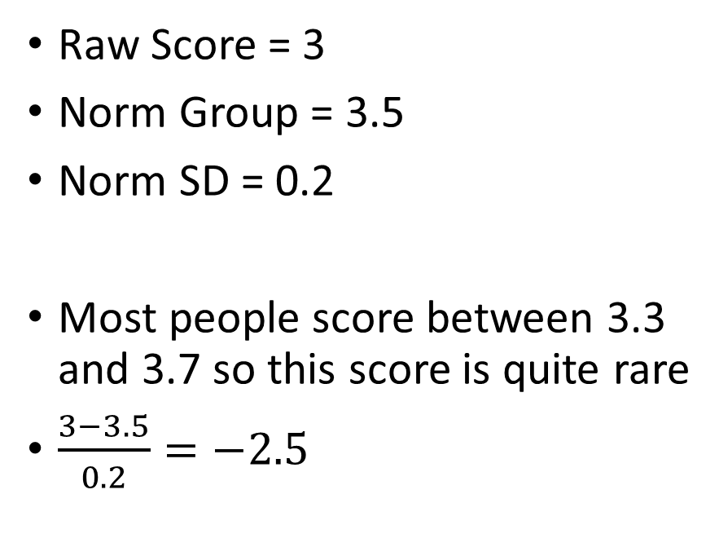
Re-cap: Standard Scores
Lower SD
Higher SD
Raw Score = 3
Norm Group = 3.5
Norm SD = 0.2
Most people score between 3.3 and 3.7 so this score is quite rare
$\frac{3−3.5}{0.2}=−2.5$
Raw Score = 3
Norm Group = 3.5
Norm SD = 1.0
Most people Score between 2.5-4.5 so 3 isn’t that rare a score
$\frac{3−3.5}{1.0}=−0.5$

Slide 20
T Scores
Tell us how far away from the mean a score is
Centred at 50
Standard Deviation of 10
Scores below 50 below the mean
Scores above 50 above the mean
No negative scores so easier to communicate
T = (Z * 10) + 50

Slide 21
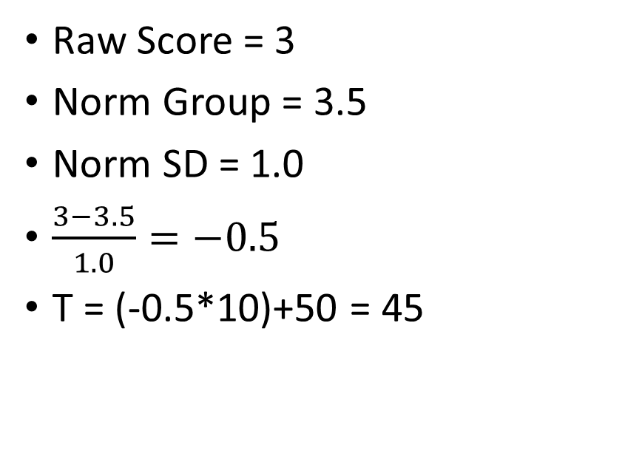
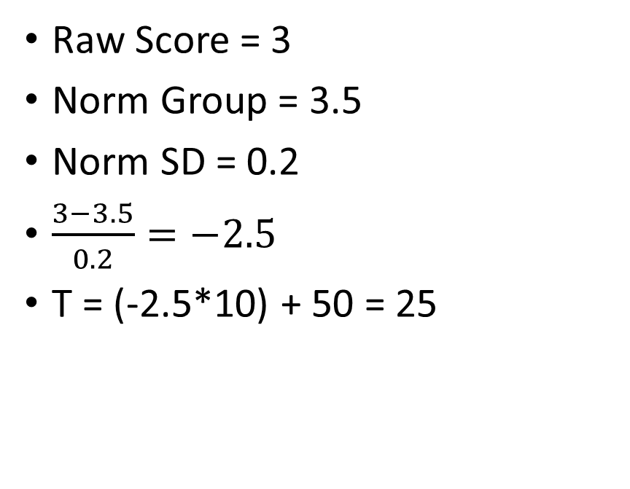
Re-cap: Standard Scores
Lower SD
Higher SD
Raw Score = 3
Norm Group = 3.5
Norm SD = 0.2
$\frac{3−3.5}{0.2}=−2.5$
T = (-2.5*10) + 50 = 25
Raw Score = 3
Norm Group = 3.5
Norm SD = 1.0
$\frac{3−3.5}{1.0}=−0.5$
T = (-0.5*10)+50 = 45

Slide 22
Practice Materials
We can give guidance on these, but not the assessment materials
Guidance can be sought in the forum and workshop sessions
Please do consider setting up a study-group to go through these on teams

Slide 23
Hour 2

Slide 24
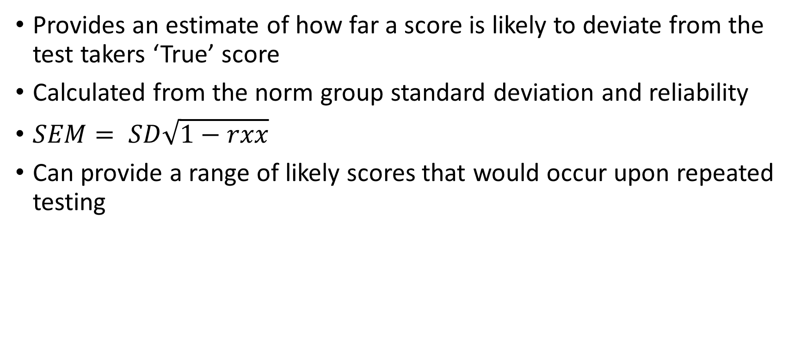
Standard Error of Measurement
Provides an estimate of how far a score is likely to deviate from the test takers ‘True’ score
Calculated from the norm group standard deviation and reliability
$SEM= SD\sqrt{1−rxx}$
Can provide a range of likely scores that would occur upon repeated testing

Slide 25
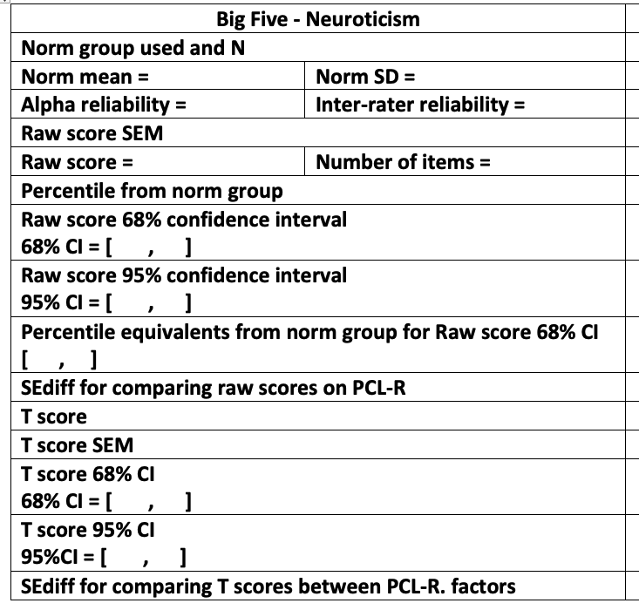
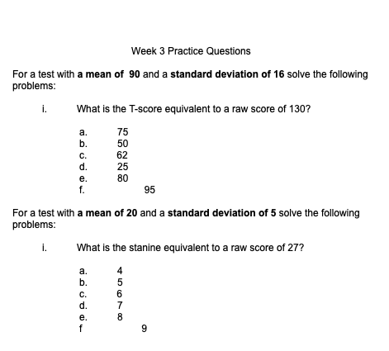
Practice Materials

Slide 26
Practice Data-Record Sheet
Big Five - Neuroticism
Norm group used and N
Unidimensional = | Tau Equivalent =
Norm mean = | Norm SD =
Alpha reliability = | Omega Reliability =
Raw score SEM
Raw score = | Number of items =
Percentile from norm group
Raw score 68% confidence interval 68% CI = [ , ]
Raw score 95% confidence interval 95% CI = [ , ]
100 MMU MSc Students
TRUE
FALSE
4.27
0.613
0.824
0.829
0.613 * √1-.829 = 0.25
3.5
10
10th
3.5 ± 0.25
3.5 ± (2 x 0.25)

Slide 27

Task 1
Work through the data record sheet for one of the Big Five factors
Notes:
Breakout room study groups? https://padlet.com/oclark15/gokuco1h7g9kr2sr

Slide 28
Post-Session Activity
Post-session reading
Activities
Practice data record sheet
Practice worksheet questions
Start working on your own dataset
We encourage you to work in groups!

